Slide 1

Repaying the Credit
Case Study

Slide 2
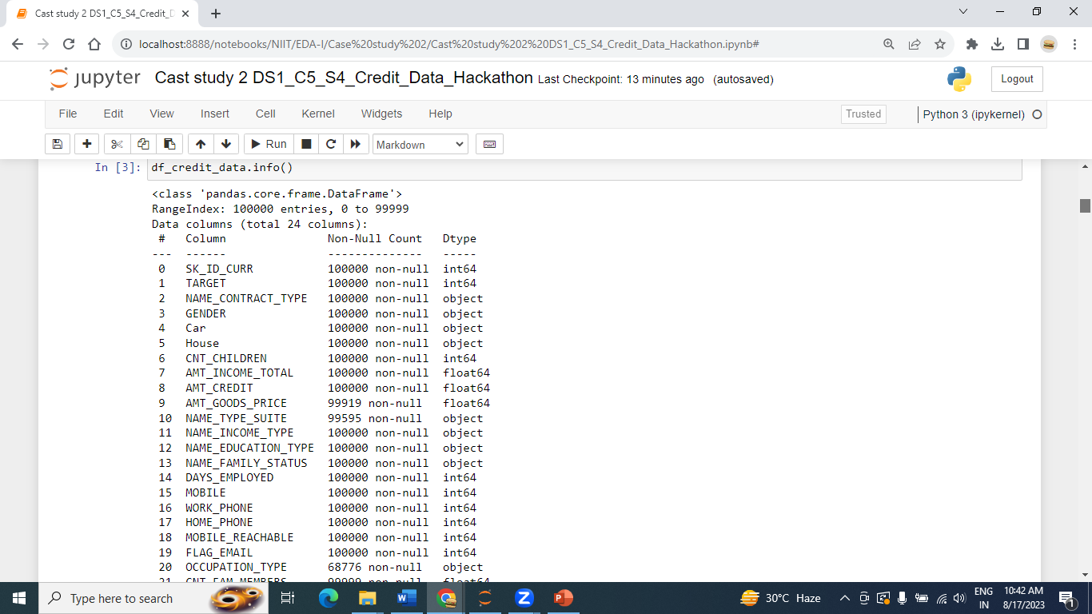
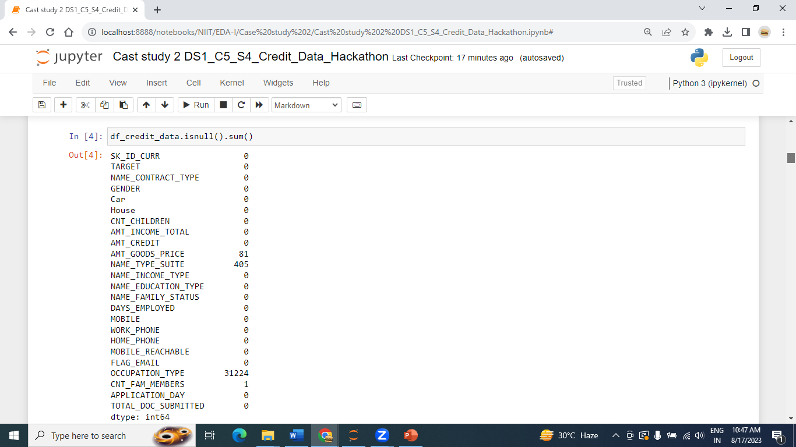
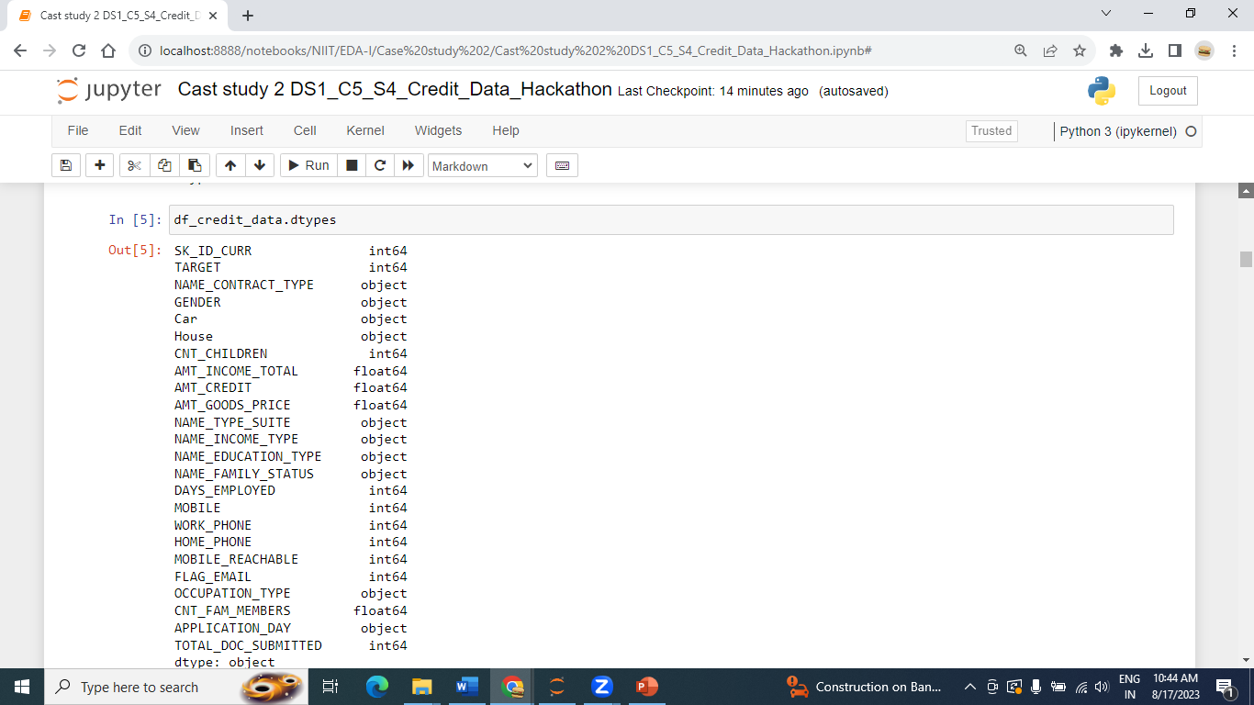
LEVEL 0 ANALYSIS --UNDERSTANDING ABOUT DATA

Slide 3
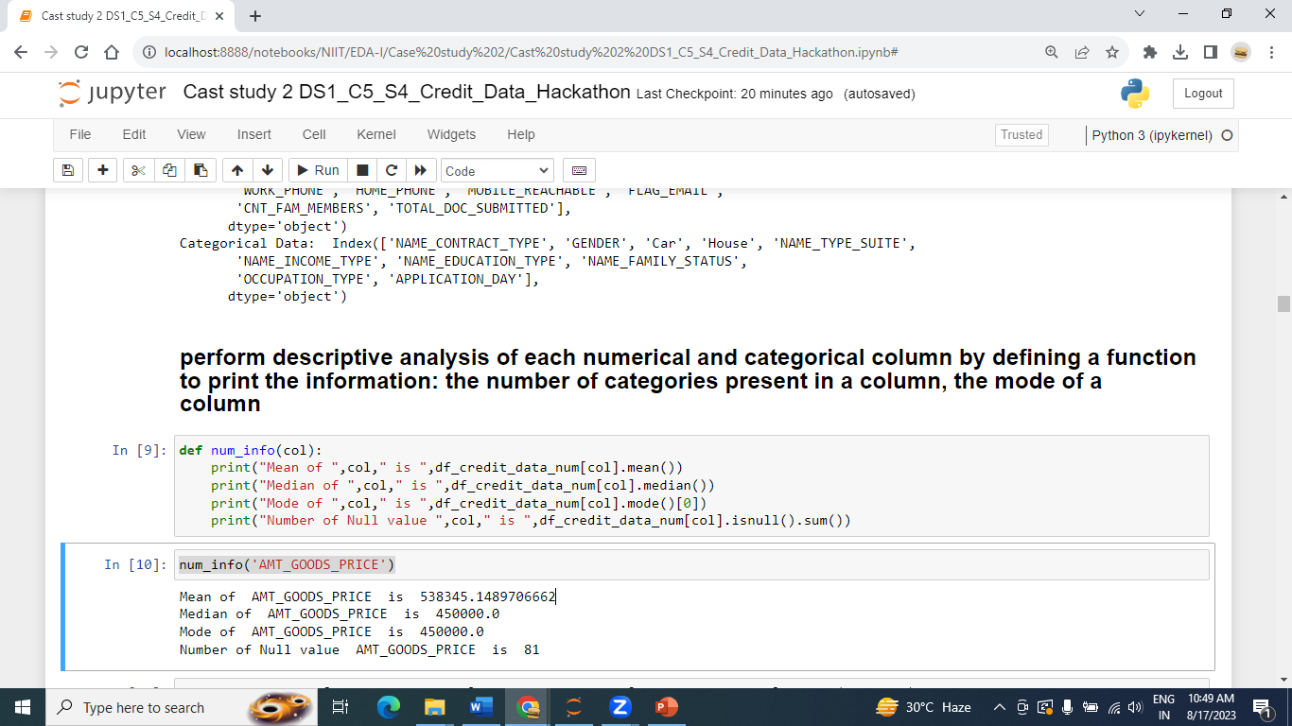
Perform descriptive analysis of each numerical and categorical columns

Slide 4
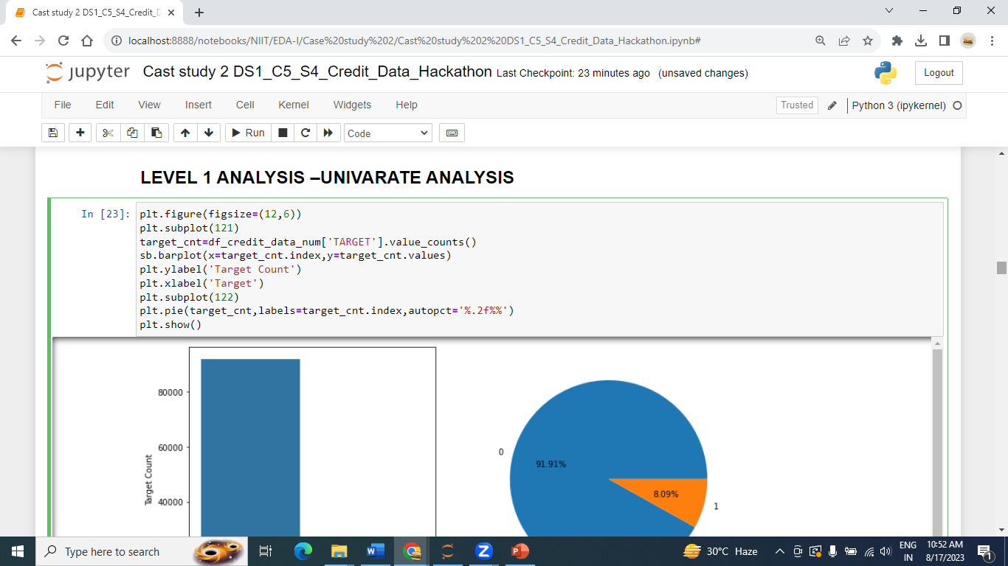
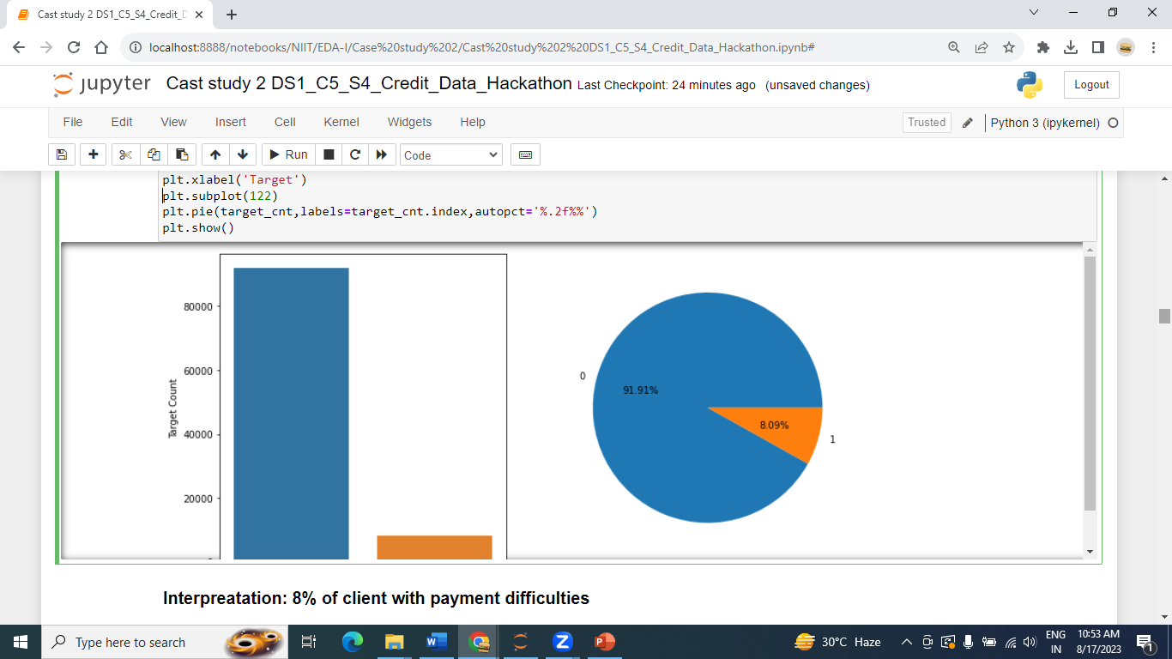
LEVEL 1 ANALYSIS –UNIVARATE ANALYSIS
Interpretation: 8% of client with payment difficulties.

Slide 5
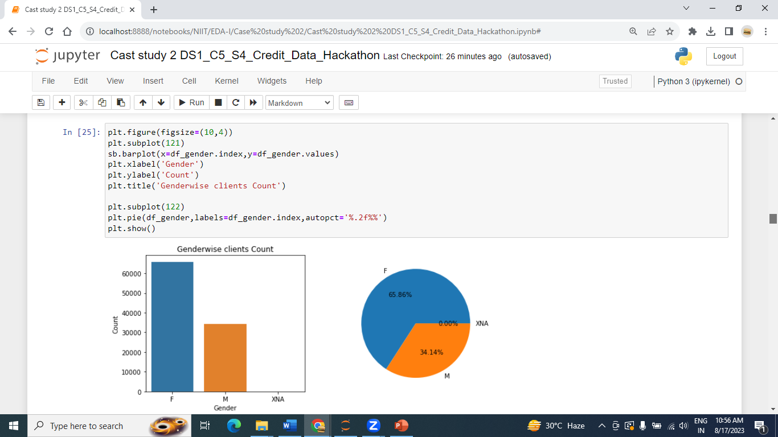
Interpretation: Female clients are more than Male clients applied for loan, 65% female and 34% male applied for loan

Slide 6
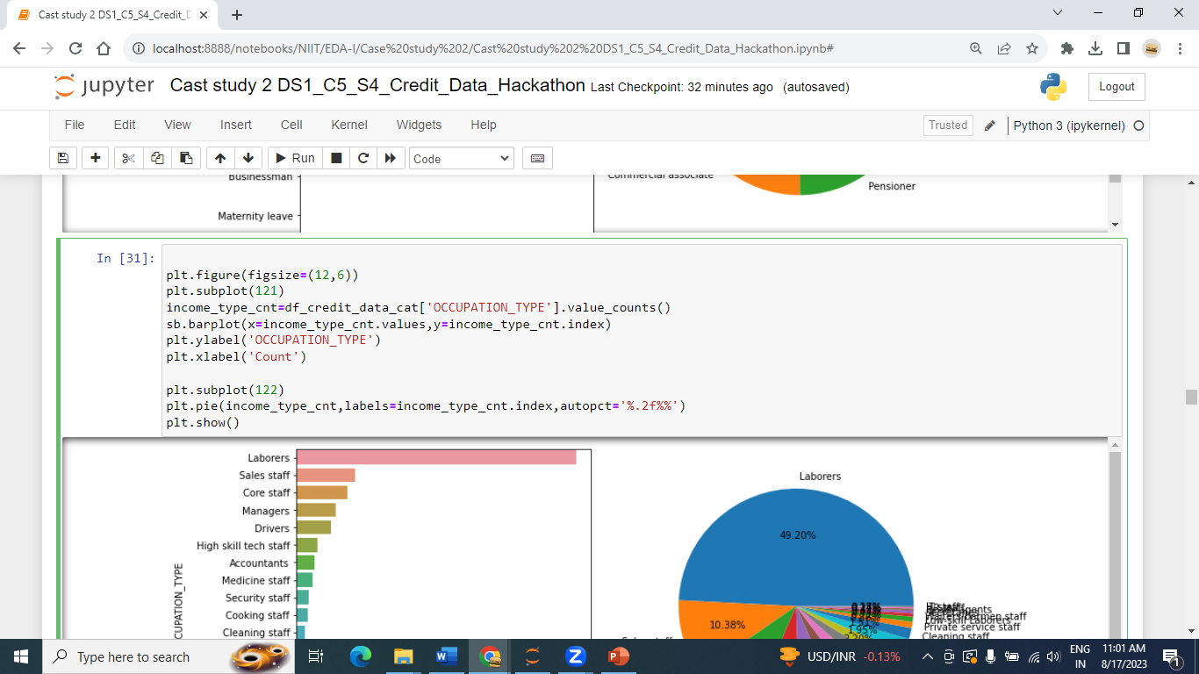
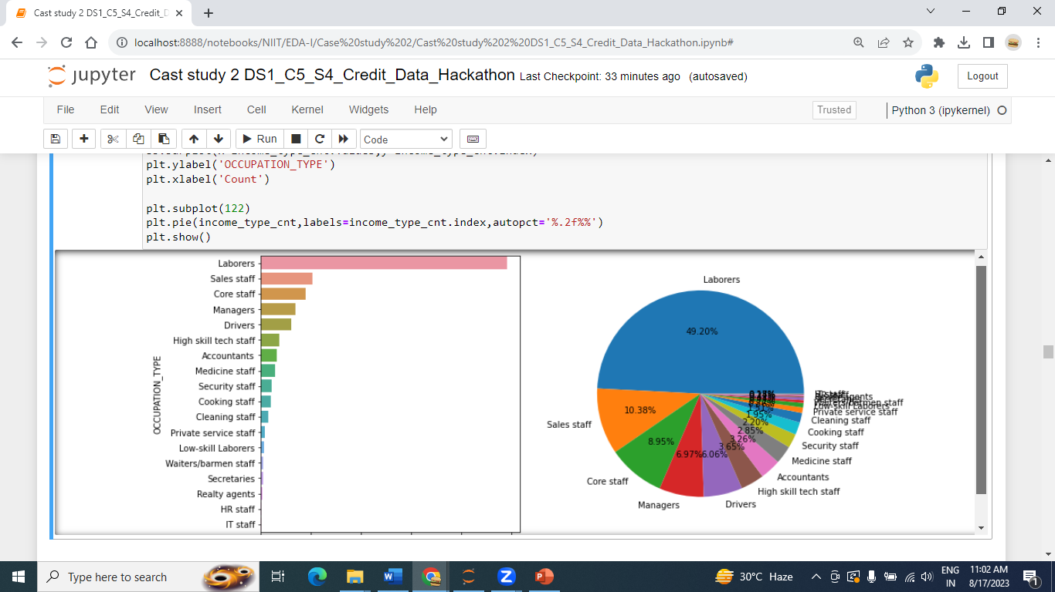
Interpretation : 50% of clients are Laborers, 10% of clients are Sales staff, 9% of clients are Core staff,7% clients are Managers and 6% of clients are Drivers who applied for Loan.

Slide 7
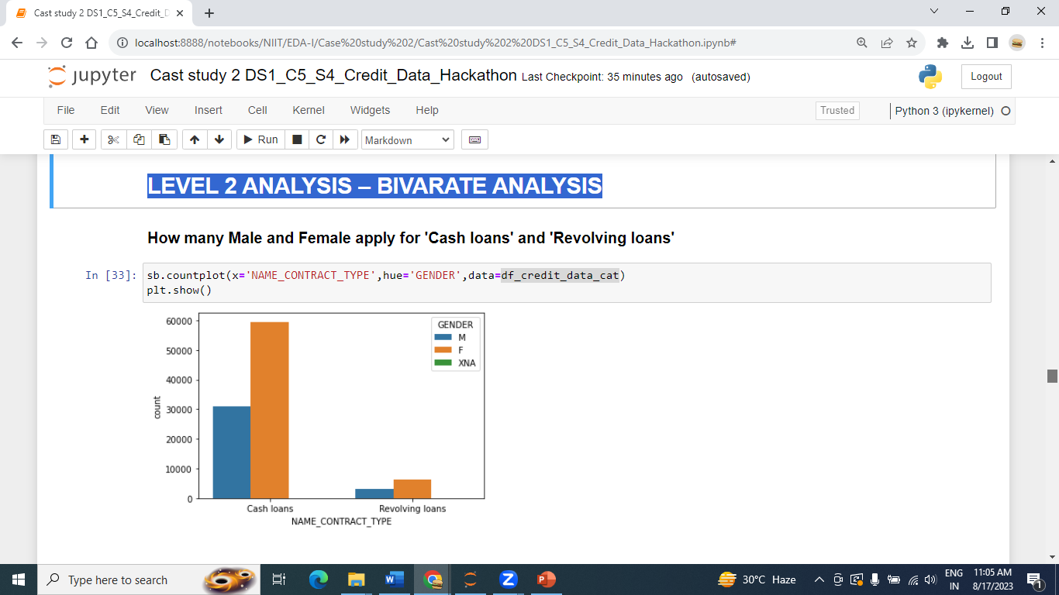
LEVEL 2 ANALYSIS – BIVARATE ANALYSIS

Slide 8
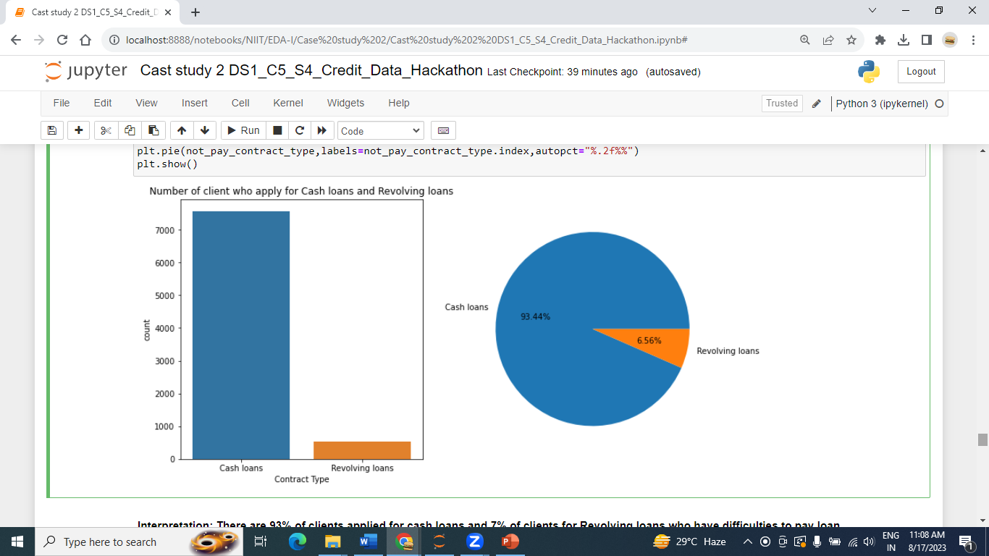
"Now we focus on TARGET,Target variable (1 - client with payment difficulties: he/she had late payment more than X days on at least one of the first Y installments of the loan in our sample"
Interpretation: There are 93% of clients applied for cash loans and 7% of clients for Revolving loans who have difficulties to pay loan

Slide 9
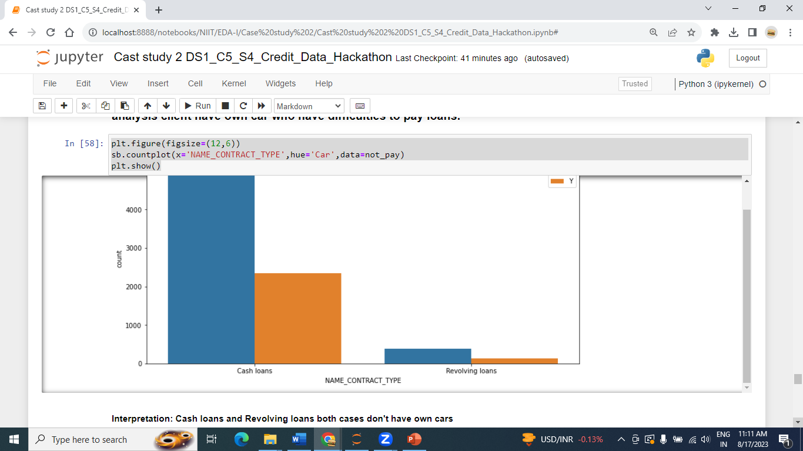
LEVEL 2 ANALYSIS – BIVARATE ANALYSIS
Interpretation: Cash loans and Revolving loans both cases don't have own cars

Slide 10
Final conclusion:
In General way-
92% of client don't have payment difficulties
90% of client applied for cash loans and 10% apply for credit card loan(Revolving loans)
Female clients are more than Male clients applied for loan, 65% female and 34% male applied for loan
69% client have own house.
50% of clients are Laborers, 10% of clients are Sales staff, 9% of clients are Core staff,7% clients are Managers and 6% of clients are Drivers who applied for Loan.
64% of Female in Laborers who apply for loan.
In Laborers only 30% client have own Car.
81% clients are Unaccompanied when they applied for the loan. 13% clients with family when the applied for the loan
Married clients applied more for loan. and Female clients count are more than Male to applied for loan.

Slide 11
"Now we focus on TARGET,Target variable (1 - client with payment difficulties: he/she had late payment more than X days on at least one of the first Y installments of the loan in our sample"
8% of client with payment difficulties
There are 93% of clients applied for cash loans and 7% of clients for Revolving loans who have difficulties to pay loan
57% Female and 43% of Male clients who have difficulties to pay loans
Cash loans and Revolving loans both case have less number of own cars but more number of own Houses.
Labores,sale_staff and driver Occupation have difficulties to pay loans
There are 50% of client have difficulties to pay loans whose work Experience is between 1 year to 4 years

